Slide 1
Chapter 8: Main Memory

Slide 2
Chapter 8: Memory Management
Background
Single user System
Fixed multiple Partitions
Variable Multiple Partitions
Placement strategies
Fragmentation
Swapping
Contiguous Memory Allocation
Paging

Slide 3
Objectives
To provide a detailed description of various ways of organizing memory hardware
To discuss various memory-management techniques, including paging and segmentation

Slide 4
Background
Memory is central to the operation of a computer system
Program must be brought (from disk) into memory and placed within a process for it to be run
Main memory and registers are only storage CPU can access directly
Memory unit only sees a stream of addresses + read requests, or address + data and write requests
Register access in one CPU clock (or less)
Main memory can take many cycles, causing a stall
Cache sits between main memory and CPU registers
Protection of memory required to ensure correct operation

Slide 5
Address Binding
Programs on disk, ready to be brought into memory to execute form an input queue
  Without support, must be loaded into address 0000
Further, addresses represented in different ways at different stages of a program’s life
  Source code addresses usually symbolic
  Compiled code addresses bind to relocatable addresses
    i.e. “14 bytes from beginning of this module”
  Linker or loader will bind relocatable addresses to absolute addresses
    i.e. 74014
  Each binding maps one address space to another

Slide 6
Binding of Instructions and Data to Memory
Address binding of instructions and data to memory addresses can happen at three different stages
  Compile time: If memory location known a priori, absolute code can be generated; must recompile code if starting location changes
  Load time: Must generate relocatable code if memory location is not known at compile time
  Execution time: Binding delayed until run time if the process can be moved during its execution from one memory segment to another
    Need hardware support for address maps (e.g., base and limit registers)

Slide 7

Multistep Processing of a User Program

Slide 8
Logical vs. Physical Address Space
The concept of a logical address space that is bound to a separate physical address space is central to proper memory management
  Logical address – generated by the CPU; also referred to as virtual address
  Physical address – address seen by the memory unit
Logical and physical addresses are the same in compile-time and load-time address-binding schemes; logical (virtual) and physical addresses differ in execution-time address-binding scheme
Logical address space is the set of all logical addresses generated by a program
Physical address space is the set of all physical addresses generated by a program

Slide 9
Memory-Management Unit (MMU)
Hardware device that at run time maps virtual to physical address
Many methods possible, covered in the rest of this chapter
To start, consider simple scheme where the value in the relocation register is added to every address generated by a user process at the time it is sent to memory
  Base register now called relocation register
  MS-DOS on Intel 80x86 used 4 relocation registers
The user program deals with logical addresses; it never sees the real physical addresses
  Execution-time binding occurs when reference is made to location in memory
  Logical address bound to physical addresses

Slide 10

Dynamic relocation using a relocation register
Routine is not loaded until it is called
Better memory-space utilization; unused routine is never loaded
All routines kept on disk in relocatable load format
Useful when large amounts of code are needed to handle infrequently occurring cases
No special support from the operating system is required
  Implemented through program design
  OS can help by providing libraries to implement dynamic loading

Slide 11
Dynamic Linking
Static linking – system libraries and program code combined by the loader into the binary program image
Dynamic linking –linking postponed until execution time
Small piece of code, stub, used to locate the appropriate memory-resident library routine
Stub replaces itself with the address of the routine, and executes the routine
Operating system checks if routine is in processes’ memory address
  If not in address space, add to address space
Dynamic linking is particularly useful for libraries
System also known as shared libraries
Consider applicability to patching system libraries
  Versioning may be needed

Slide 12
Swapping
A process can be swapped temporarily out of memory to a backing store, and then brought back into memory for continued execution
  Total physical memory space of processes can exceed physical memory
Backing store – fast disk large enough to accommodate copies of all memory images for all users; must provide direct access to these memory images
Roll out, roll in – swapping variant used for priority-based scheduling algorithms; lower-priority process is swapped out so higher-priority process can be loaded and executed
Major part of swap time is transfer time; total transfer time is directly proportional to the amount of memory swapped
System maintains a ready queue of ready-to-run processes which have memory images on disk

Slide 13
Swapping (Cont.)
Does the swapped out process need to swap back in to same physical addresses?
Depends on address binding method
  Plus consider pending I/O to / from process memory space
Modified versions of swapping are found on many systems (i.e., UNIX, Linux, and Windows)
  Swapping normally disabled
  Started if more than threshold amount of memory allocated
  Disabled again once memory demand reduced below threshold

Slide 14

Schematic View of Swapping

Slide 15
Context Switch Time including Swapping
If next processes to be put on CPU is not in memory, need to swap out a process and swap in target process
Context switch time can then be very high
100MB process swapping to hard disk with transfer rate of 50MB/sec
  Swap out time of 2000 ms
  Plus swap in of same sized process
  Total context switch swapping component time of 4000ms (4 seconds)
Can reduce if reduce size of memory swapped – by knowing how much memory really being used
  System calls to inform OS of memory use via request_memory() and release_memory()

Slide 16
Context Switch Time and Swapping (Cont.)
Other constraints as well on swapping
  Pending I/O – can’t swap out as I/O would occur to wrong process
  Or always transfer I/O to kernel space, then to I/O device
    Known as double buffering, adds overhead
Standard swapping not used in modern operating systems
  But modified version common
    Swap only when free memory extremely low

Slide 17
Swapping on Mobile Systems
Not typically supported
  Flash memory based
    Small amount of space
    Limited number of write cycles
    Poor throughput between flash memory and CPU on mobile platform
Instead use other methods to free memory if low
  iOS asks apps to voluntarily relinquish allocated memory
    Read-only data thrown out and reloaded from flash if needed
    Failure to free can result in termination
  Android terminates apps if low free memory, but first writes application state to flash for fast restart
  Both OSes support paging as discussed below

Slide 18
Contiguous Allocation
Main memory must support both OS and user processes
Limited resource, must allocate efficiently
Contiguous allocation is one early method
Main memory usually into two partitions:
  Resident operating system, usually held in low memory with interrupt vector
  User processes then held in high memory
  Each process contained in single contiguous section of memory

Slide 19
Contiguous Allocation (Cont.)
Relocation registers used to protect user processes from each other, and from changing operating-system code and data
  Base register contains value of smallest physical address
  Limit register contains range of logical addresses – each logical address must be less than the limit register
  MMU maps logical address dynamically
  Can then allow actions such as kernel code being transient and kernel changing size

Slide 20

Hardware Support for Relocation and Limit Registers

Slide 21
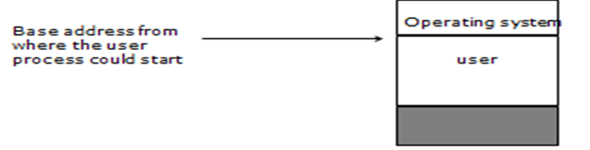
Single user System
Two partitions of main memory – one for the operating system and one for the user
The memory manager simply make sure that the user process does not access memory below a specific address

Slide 22
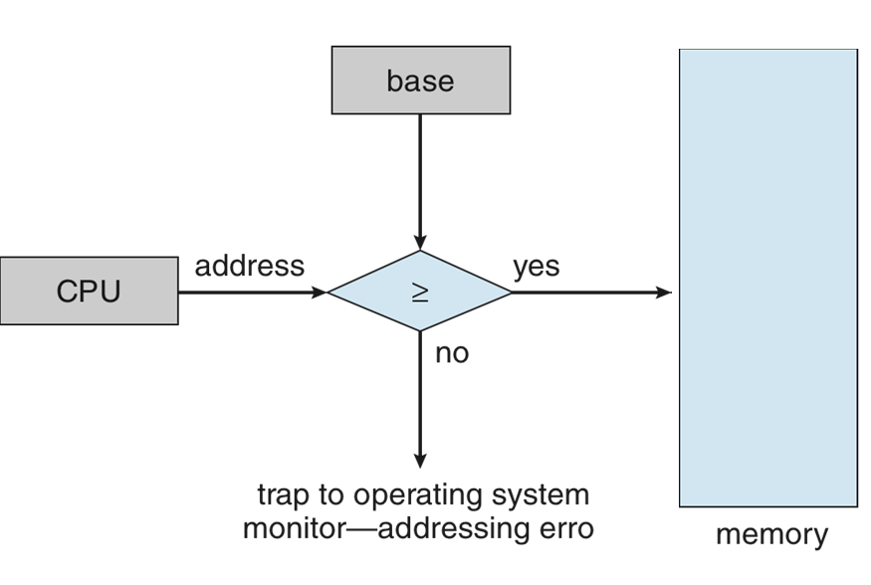
Single user System

Slide 23
Multiprocessing - Different approaches
Multiprocessing requires that several processes share main memory. This can be done in many ways:
  Partition memory into fixed size chunks
  Partition memory into variable size chunks
  Keep a process in the same memory space as it executes
  Allow a process to change memory location as it executes
  Require that a process be placed in one uninterrupted block
  Allow a process to be placed into separate portions of memory

Slide 24
Multiple Fixed Partitions
In early multiprogramming systems:
  Only a single job at a time per partition
  Processes were assigned absolute addresses at compile time
This is inefficient because for example partition 2 could be empty while there are processes waiting in queue 3. CPU and memory utilization would suffer
CPU
High-level scheduler 1
Base address
Partition 1
Limit address
Partition 2
High-level scheduler 2
Partition 3
High-level scheduler 3

Slide 25
Multiple Fixed Partitions
Processes were assigned relocatable addresses at compile time
Physical addresses were assigned at load time
Processes could run in any partition that they could fit
This is still inefficient because a process may not occupy the entire partition, while another may wait because the partition open is too small
CPU
Base address
Partition 1
Limit address
High-level scheduler
Partition 2
Partition 3

Slide 26
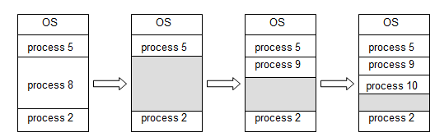
Multiple Variable Partitions
Processes are assigned as much memory as they need. There are no fixed boundaries among partitions but interrupted memory is still needed

Slide 27

Multiple-partition allocation
Multiple-partition allocation
  Degree of multiprogramming limited by number of partitions
  Variable-partition sizes for efficiency (sized to a given process’ needs)
  Hole – block of available memory; holes of various size are scattered throughout memory
  When a process arrives, it is allocated memory from a hole large enough to accommodate it
  Process exiting frees its partition, adjacent free partitions combined
  Operating system maintains information about:
  a) allocated partitions b) free partitions (hole)

Slide 28
Dynamic Storage-Allocation Problem
How to satisfy a request of size n from a list of free holes?
First-fit: Allocate the first hole that is big enough
Best-fit: Allocate the smallest hole that is big enough; must search entire list, unless ordered by size
  Produces the smallest leftover hole
Worst-fit: Allocate the largest hole; must also search entire list
  Produces the largest leftover hole
First-fit and best-fit better than worst-fit in terms of speed and storage utilization

Slide 29
Fragmentation
External Fragmentation – total memory space exists to satisfy a request, but it is not contiguous
Internal Fragmentation – allocated memory may be slightly larger than requested memory; this size difference is memory internal to a partition, but not being used
First fit analysis reveals that given N blocks allocated, 0.5 N blocks lost to fragmentation
  1/3 may be unusable -> 50-percent rule

Slide 30
Fragmentation (Cont.)
Reduce external fragmentation by compaction
  Shuffle memory contents to place all free memory together in one large block
  Compaction is possible only if relocation is dynamic, and is done at execution time
  I/O problem
    Latch job in memory while it is involved in I/O
    Do I/O only into OS buffers
Now consider that backing store has same fragmentation problems

Slide 31
Paging
Physical address space of a process can be noncontiguous; process is allocated physical memory whenever the latter is available
  Avoids external fragmentation
  Avoids problem of varying sized memory chunks
Divide physical memory into fixed-sized blocks called frames
  Size is power of 2, between 512 bytes and 16 Mbytes
Divide logical memory into blocks of same size called pages
Keep track of all free frames
To run a program of size N pages, need to find N free frames and load program
Set up a page table to translate logical to physical addresses
Backing store likewise split into pages
Still have Internal fragmentation

Slide 32

Address Translation Scheme
Address generated by CPU is divided into:
  Page number (p) – used as an index into a page table which contains base address of each page in physical memory
  Page offset (d) – combined with base address to define the physical memory address that is sent to the memory unit
  For given logical address space 2^{m} and page size 2^{n}

Slide 33

Paging Hardware

Slide 34

Paging Model of Logical and Physical Memory

Slide 35

Paging Example
n=2 and m=4 32-byte memory and 4-byte pages

Slide 36
Paging (Cont.)
Calculating internal fragmentation
  Page size = 2,048 bytes
  Process size = 72,766 bytes
  35 pages + 1,086 bytes
  Internal fragmentation of 2,048 - 1,086 = 962 bytes
  Worst case fragmentation = 1 frame – 1 byte
  On average fragmentation = 1 / 2 frame size
  So small frame sizes desirable?
  But each page table entry takes memory to track
  Page sizes growing over time
    Solaris supports two page sizes – 8 KB and 4 MB
Process view and physical memory now very different
By implementation process can only access its own memory

Slide 37

Free Frames
Before allocation
After allocation

Slide 38
Implementation of Page Table
Page table is kept in main memory
Page-table base register (PTBR) points to the page table
Page-table length register (PTLR) indicates size of the page table
In this scheme every data/instruction access requires two memory accesses
  One for the page table and one for the data / instruction
The two memory access problem can be solved by the use of a special fast-lookup hardware cache called associative memory or translation look-aside buffers (TLBs)

Slide 39
Implementation of Page Table (Cont.)
Some TLBs store address-space identifiers (ASIDs) in each TLB entry – uniquely identifies each process to provide address-space protection for that process
  Otherwise need to flush at every context switch
TLBs typically small (64 to 1,024 entries)
On a TLB miss, value is loaded into the TLB for faster access next time
  Replacement policies must be considered
  Some entries can be wired down for permanent fast access

Slide 40
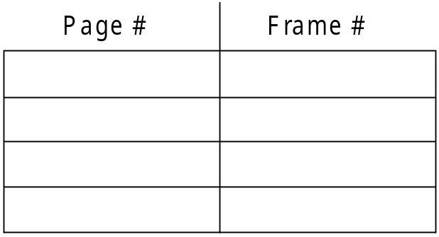
Associative Memory
Associative memory – parallel search
Address translation (p, d)
  If p is in associative register, get frame # out
  Otherwise get frame # from page table in memory

Slide 41

Paging Hardware With TLB

Slide 42
Effective Access Time
Associative Lookup = ε time unit
  Can be < 10% of memory access time
Hit ratio = α
  Hit ratio – percentage of times that a page number is found in the associative registers; ratio related to number of associative registers
Consider α = 80%, ε = 20ns for TLB search, 100ns for memory access
Effective Access Time (EAT)
EAT = (1 + ε) α + (2 + ε)(1 – α)
= 2 + ε – α
Consider α = 80%, ε = 20ns for TLB search, 100ns for memory access
  EAT = 0.80 x 100 + 0.20 x 200 = 120ns
Consider more realistic hit ratio -> α = 99%, ε = 20ns for TLB search, 100ns for memory access
  EAT = 0.99 x 100 + 0.01 x 200 = 101ns

Slide 43
Questions
If access memory reference takes 150 nanoseconds, how long does a paged memory reference take?
If we add TLBs, and 55 percent of all page table references are found in the TLBs what is effective memory reference time? (Assume that finding a page table entry in the TLBs takes 5 nanoseconds)

Slide 44
End of Chapter 8

